Slide 1


UNIT-VI
Conflict and Stress Management
“Stress Management” by
P. B. Narendra Kiran M.B.A., M.Phil., (Ph.D.)
Assistant Professor
Mittal School of Business, L.P.U., Phagwara, Punjab
Lecture-36

Slide 2


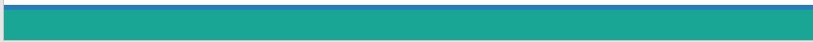

Slide 3

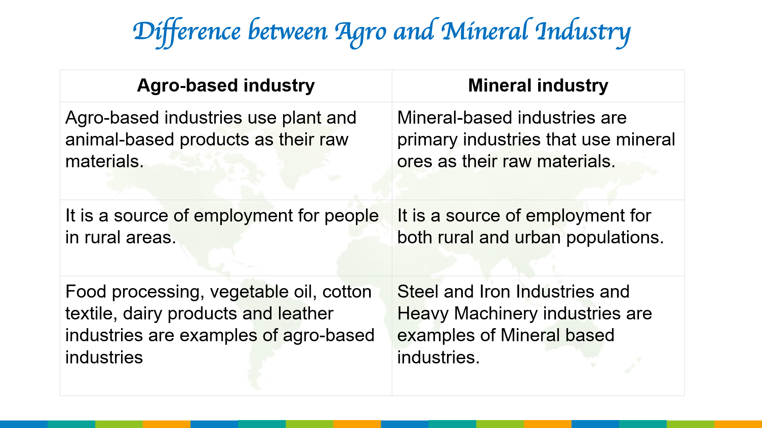
Objectives of the Study
To know the Concept of Stress and Stress Management
To acknowledge the Sources of Stress and Types of Stress
To examine what Stress causes
To practice the Stress Management Techniques

Slide 4
Introduction

Slide 5
What is Stress ?
Stress is simply a reaction to a stimulus that disturbs our physical or mental equilibrium. In other words, its an omnipresent part of life.
Stress is the reaction people to excessive pressures or other types of demand placed upon them.
It arises when they worry that they can’t cope.
It is defined as a state of mental & emotional pressure or stain, caused by challenging circumstances.

Slide 6
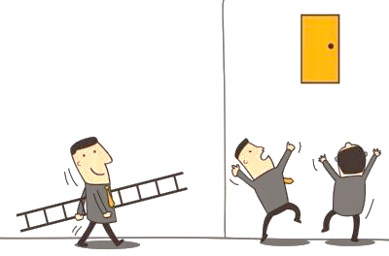
Challenges
21st
Century Challenges

Slide 7
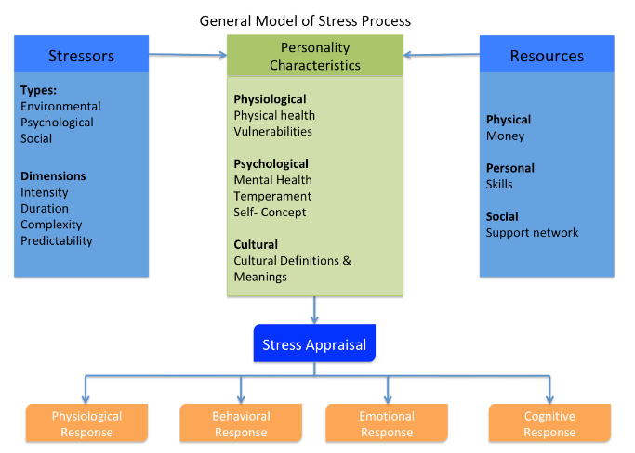
Nature of Stress

Slide 8
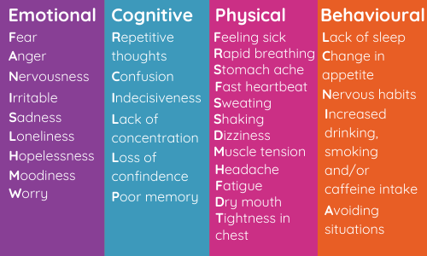
Signs or Symptoms of Stress

Slide 9
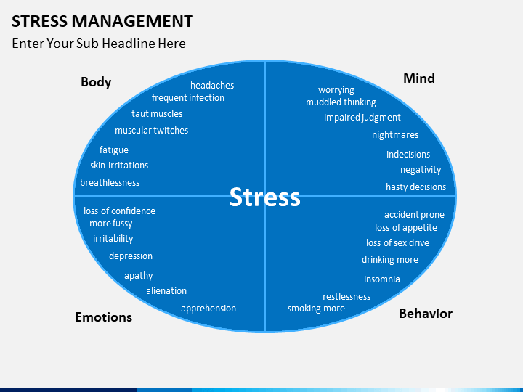
Stress is defined as “the reactions of individuals to new or threatening factors in their work environments”.

Slide 10
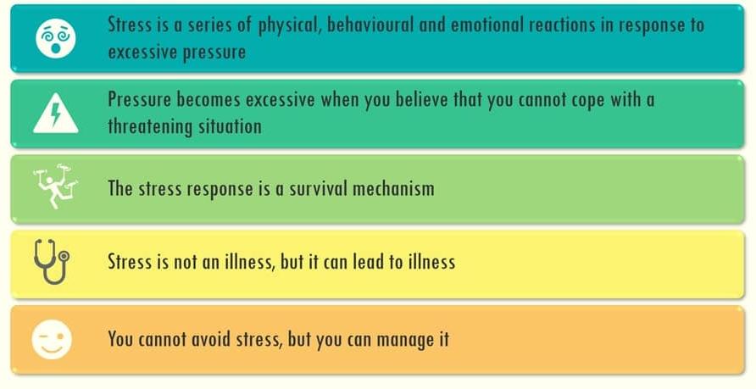
Facts about Stress

Slide 11
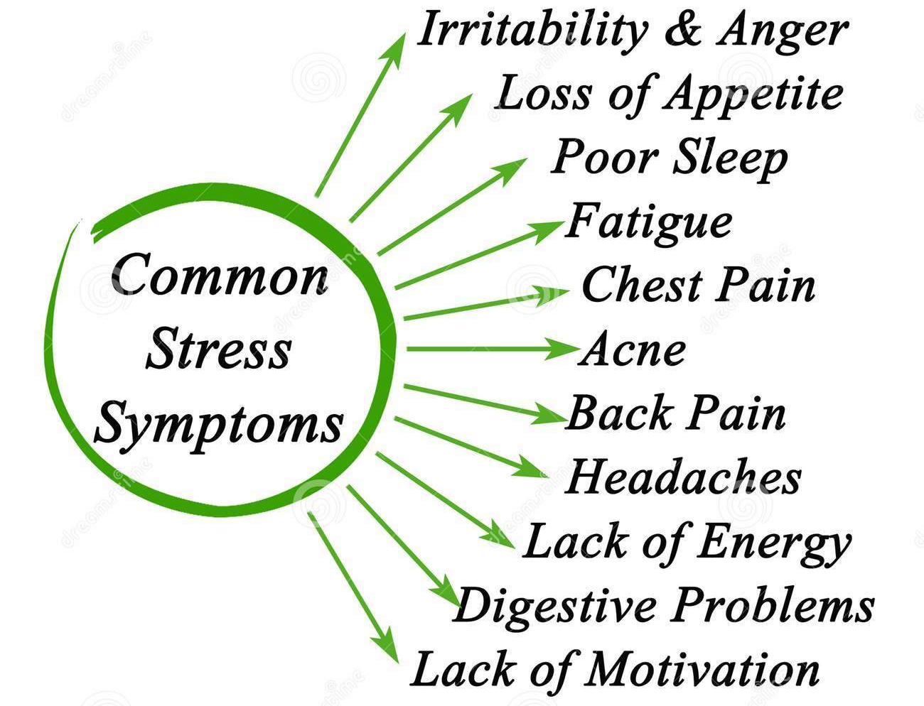

Slide 12
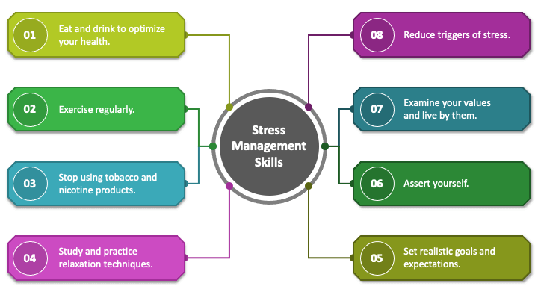
Stress Management Skills

Slide 13
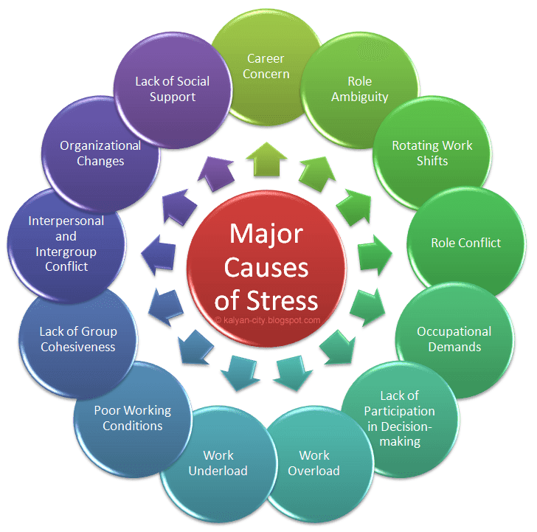

Slide 14
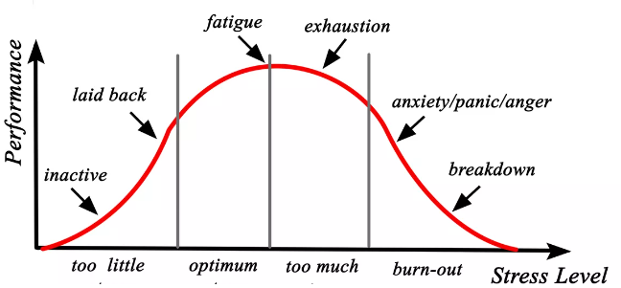
Stress Curve

Slide 15
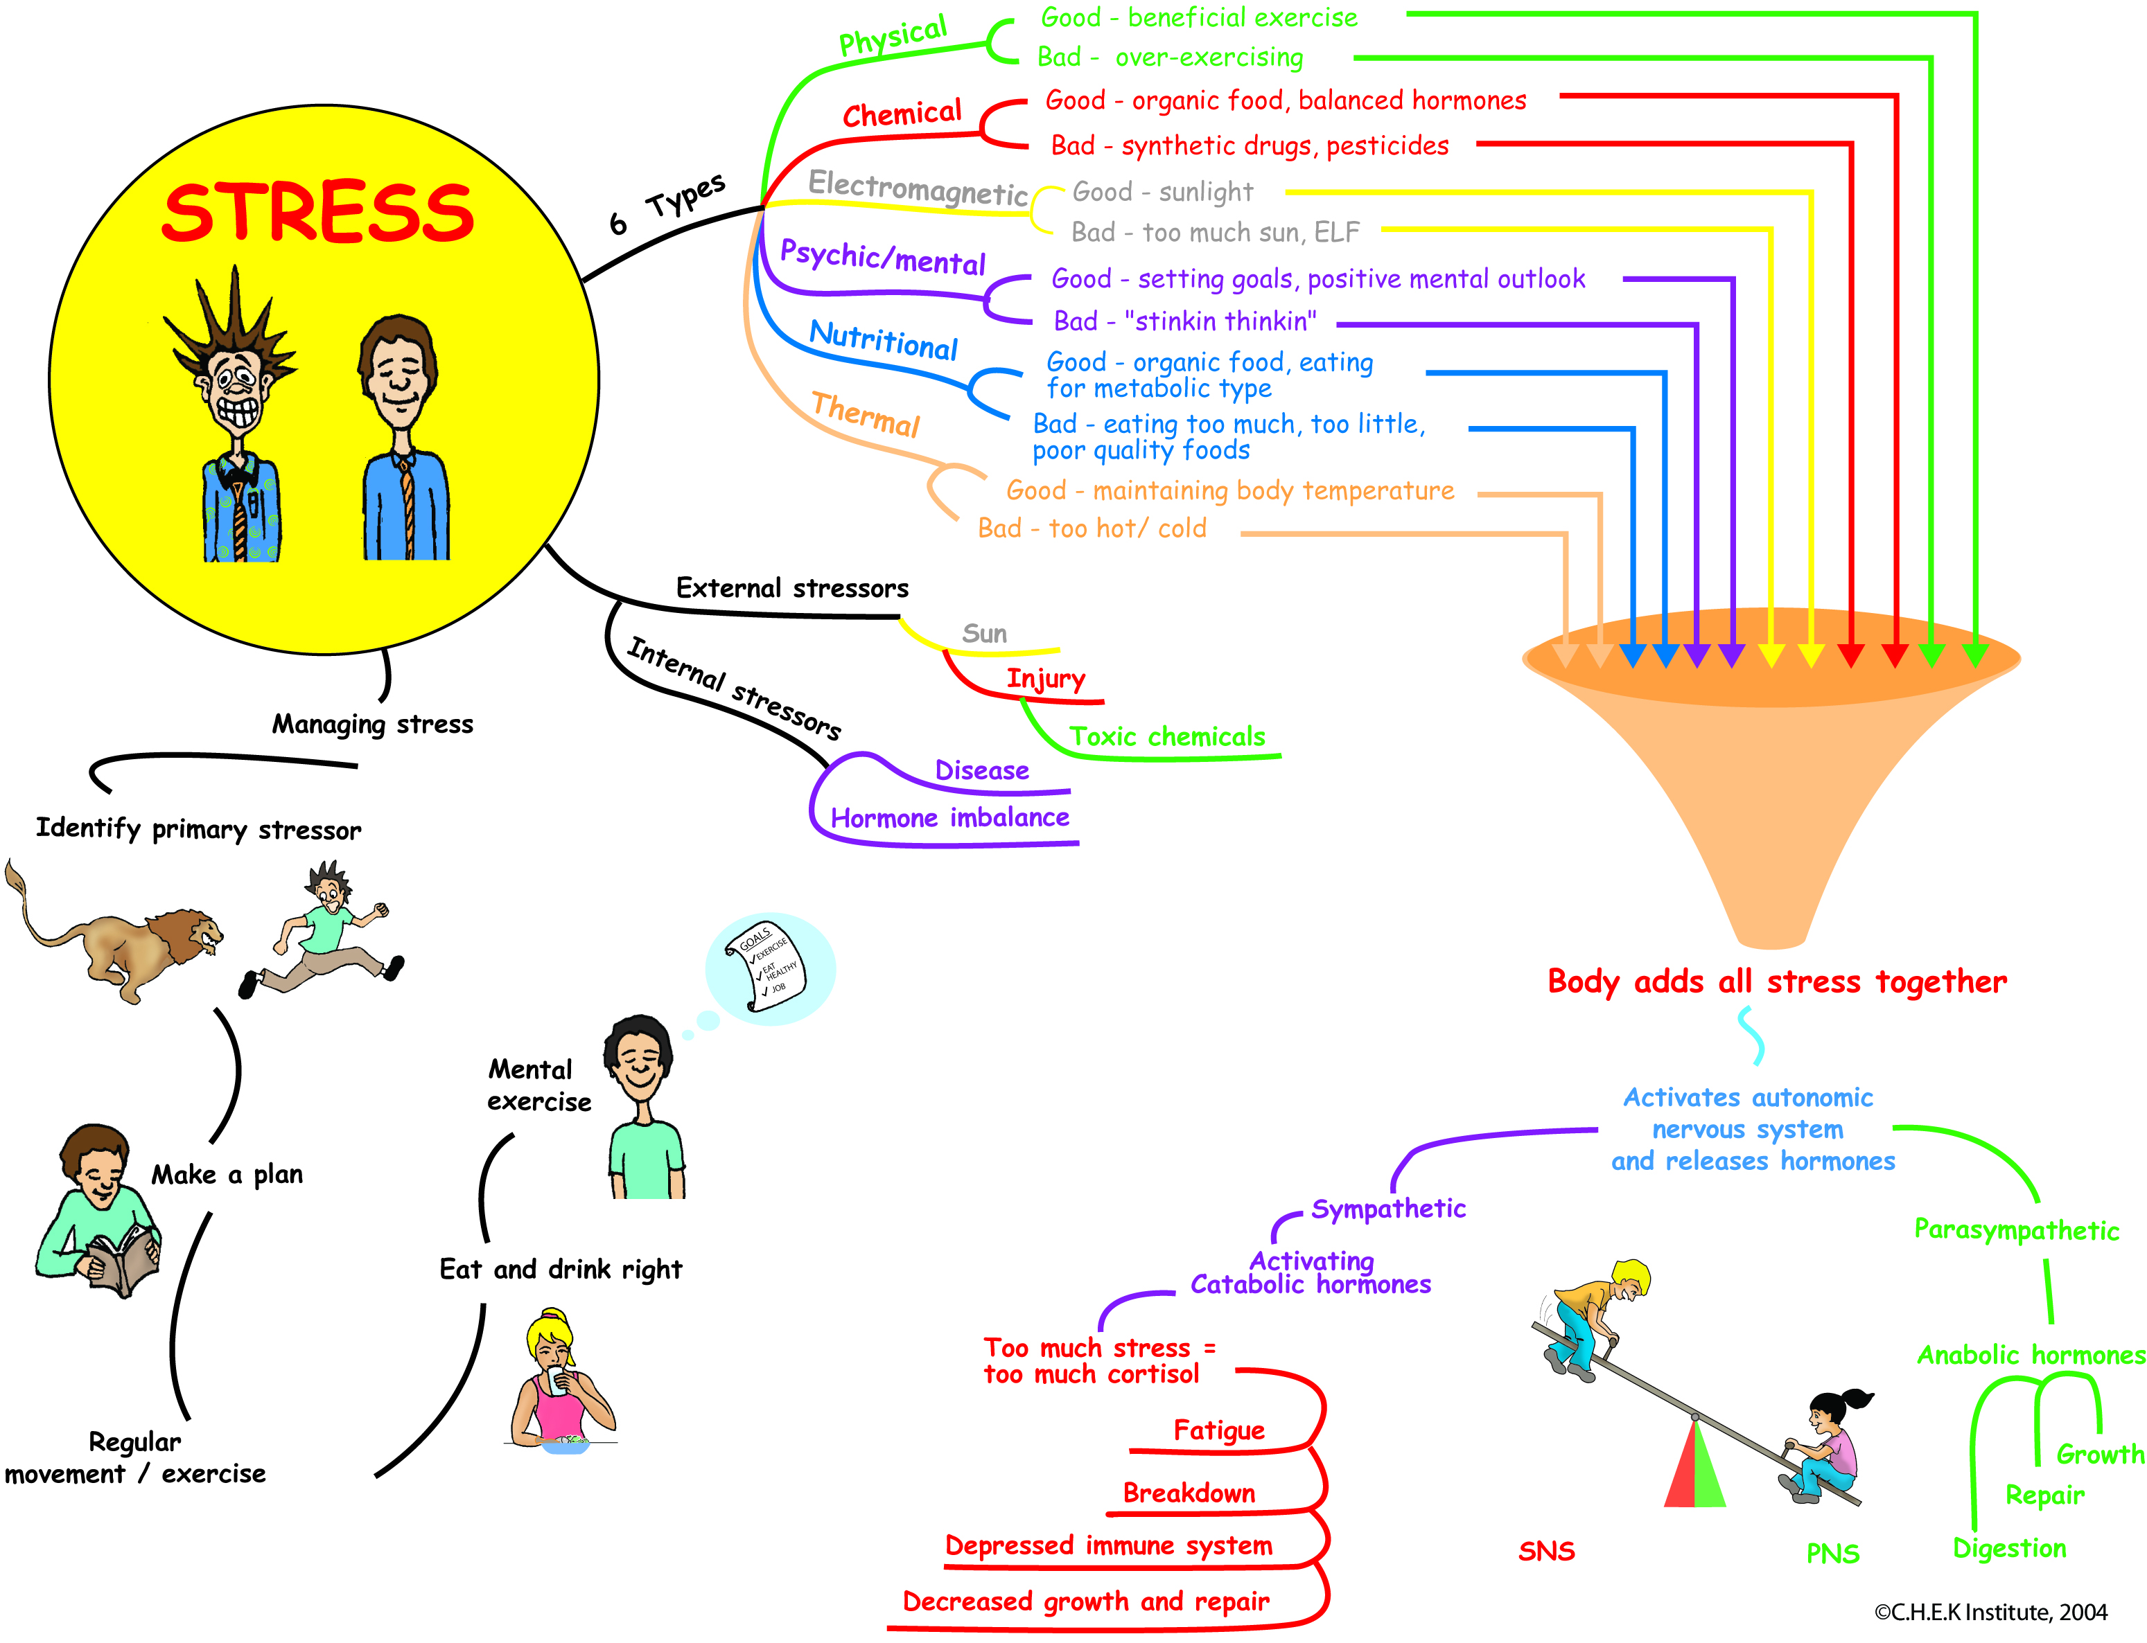
Building a high performance Organisational Culture

Slide 16
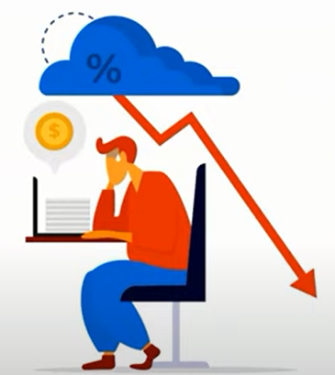
Stress Management Techniques / Strategies
Time Management
Self-limitations
Friendly social network
Reduce the noise
ABC technique
Healthy Diet
Exercise
Meditation
Sleep habit

Slide 17
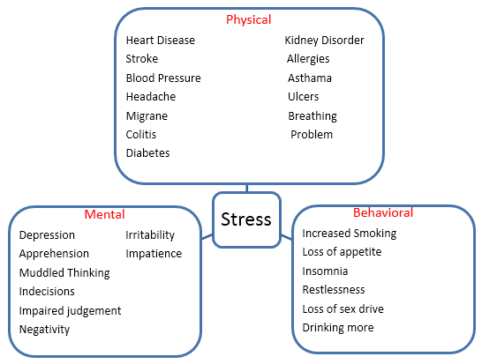
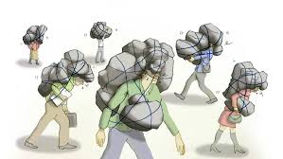
Stress Effects

Slide 18
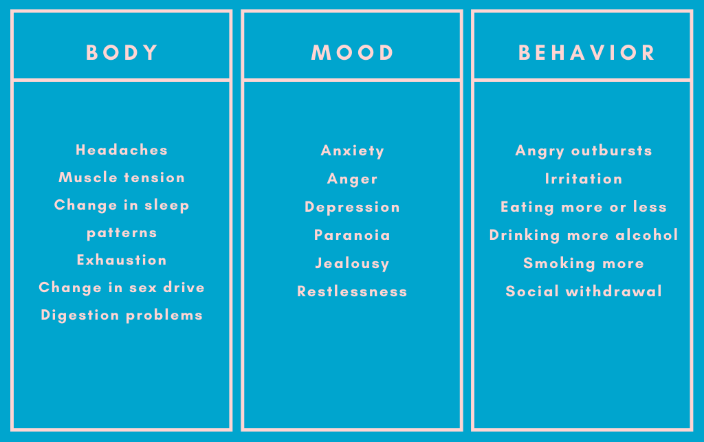
Forms of Stress and their Diagnosis

Slide 19

Any Questions

Slide 20
Thank You

